Slide 1
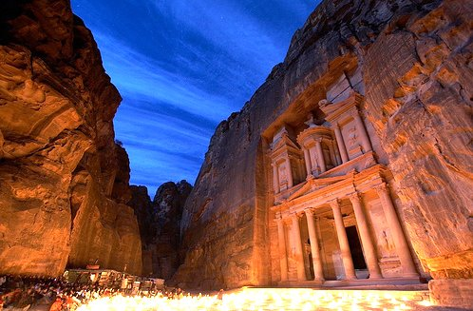
City of Petra, in Jordan one of the 7 New Wonders of the World
Music: "Helwa Already Baladi" (My Country is Beautiful) Singer: Dalidá

Slide 2
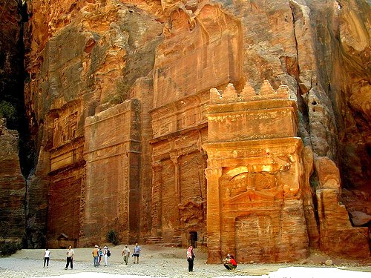
For 600 years thought that this city, in the middle of the desert of Jordan, was legendary like the Atlantis and Troy

Slide 3
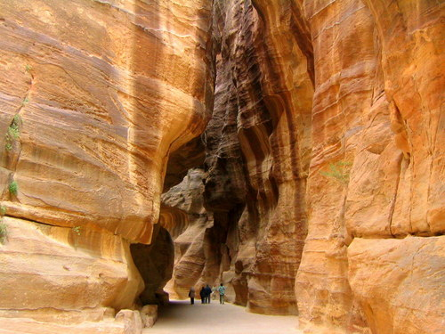
The Swiss explorer that managed to find it had to travel through impressive paths as this, among mountains of stone.

Slide 4
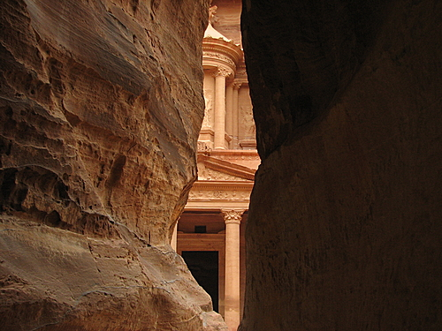
Imagine its emotion when, upon arriving for the first time, saw this scene in the 19th century!

Slide 5
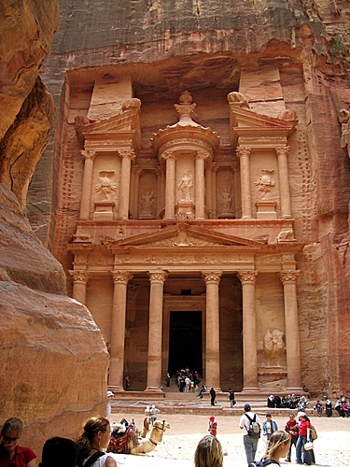
The Palace of Petra, a temple in Greek style (Hellenic), is also called "The Treasure" and has 42m. of height

Slide 6
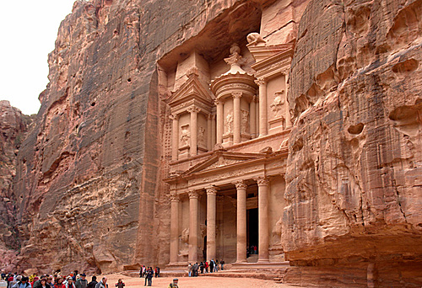
Completely it was carved in calcareous rock.

Slide 7
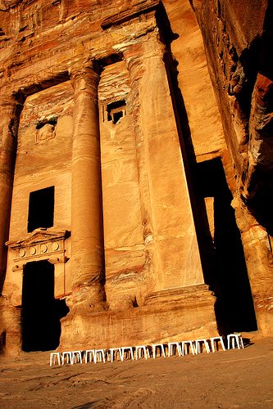
But the palace
is only one among
the many magnificent
constructions in Petra,
all carved in
calcareous rock.

Slide 8
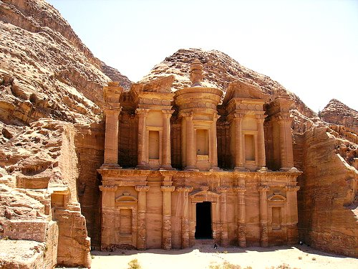
Petra was constructed towards the 6th century BC. by the Nabatéens, during the
Persian Empire.

Slide 9
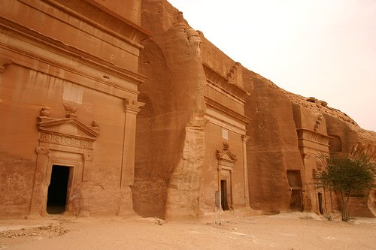
The Nabateos were Bedouins that lived on the commerce of spices, like incense, myrrh and aromatic plants.
.

Slide 10
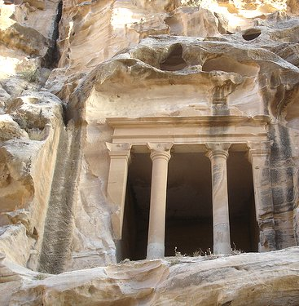
By the year 60 AD. Petra was conquered and enclosed to the Roman Empire.

Slide 11
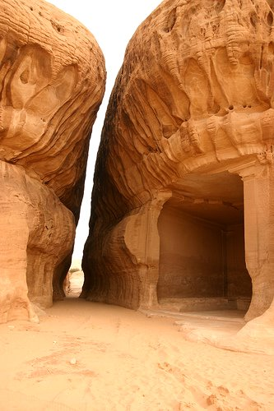
Through the years,
the wind has left
its contribution,
carving the most
beautiful forms
in the mountains of
calcareous rock.

Slide 12
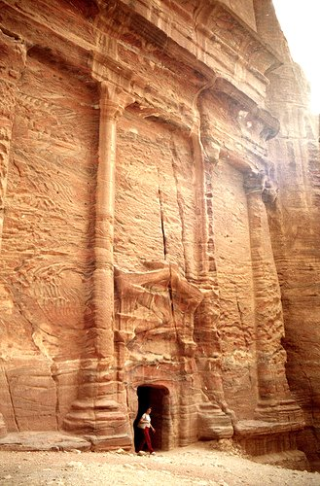
Petra was utilized for the final scene of the movies Indiana Jones and The Last Crusade

Slide 13
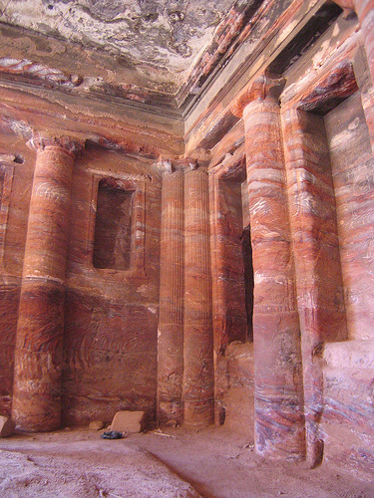
They pay attention
to the details
carved of
the interiors.

Slide 14
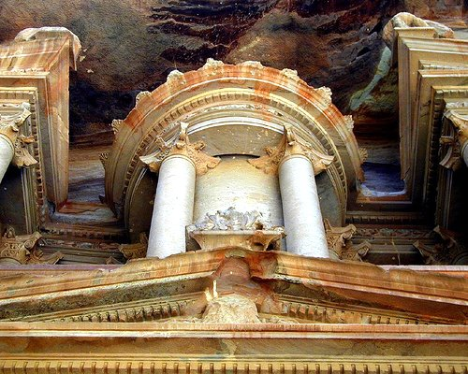
The colors in the stones are natural.

Slide 15
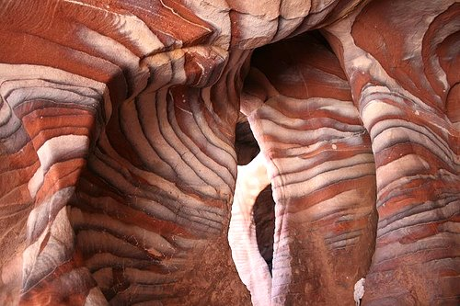
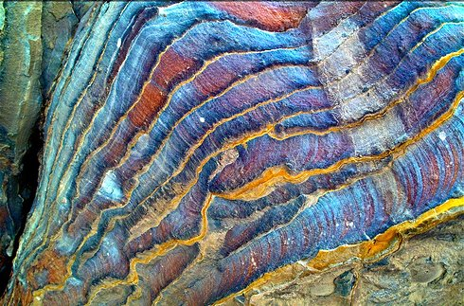
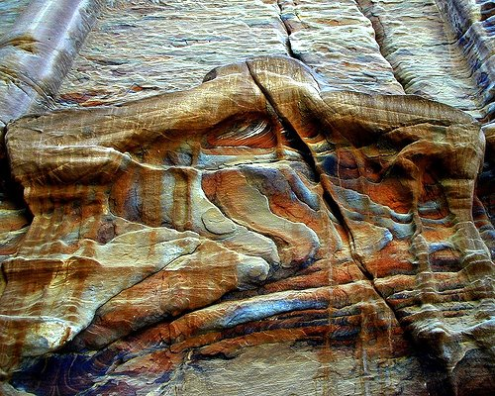
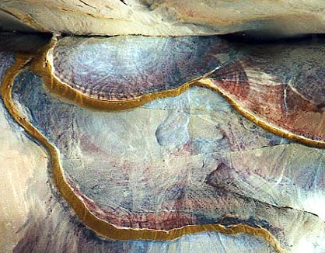
It is that it colored geological composition of the sand is favorable for "paintings" natural as these.

Slide 16
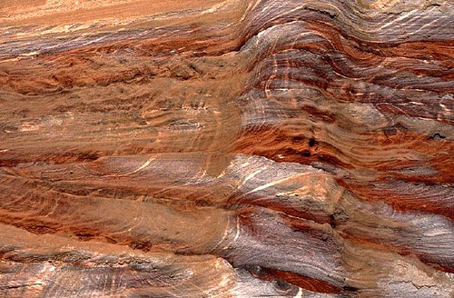
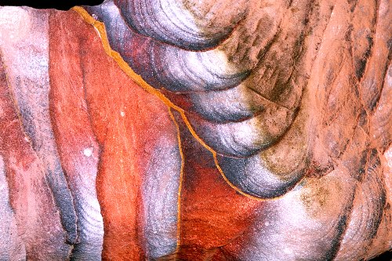
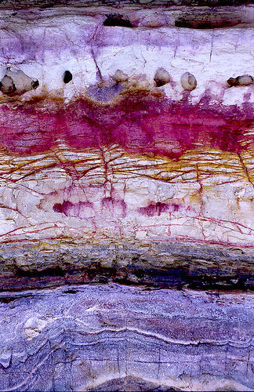
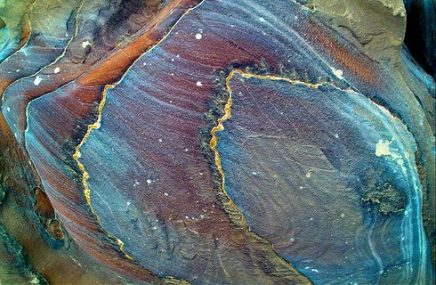
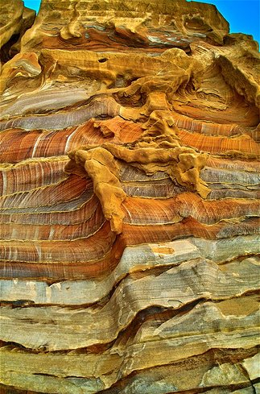
Or these formations to remove the breath, found in the walls of some mountains.

Slide 17
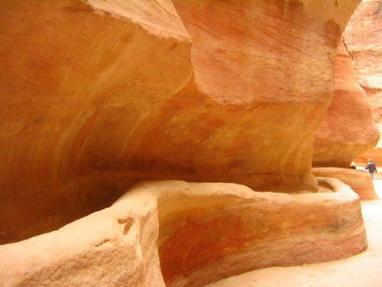
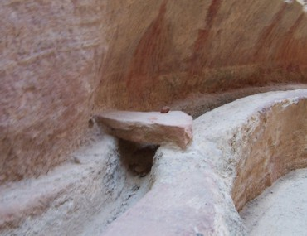
The nabateos built in Petra a sophisticated hydraulic system with tunnels and tanks of water

Slide 18
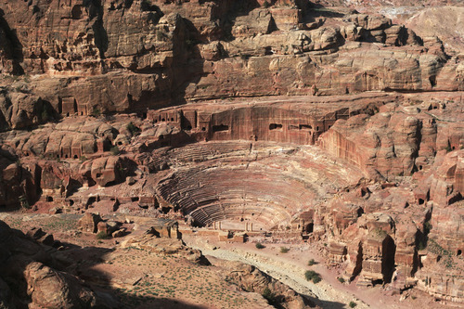
This theater, in Greek-Roman style, had capacity for 4.000 spectators.

Slide 19
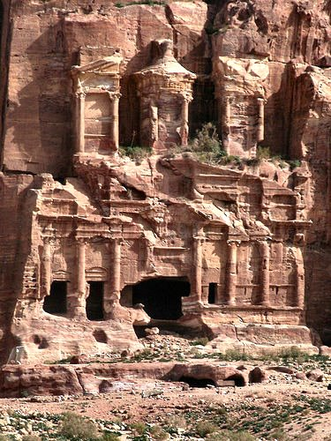
In the year 551 a second great earthquake destroyed almost all the city, and Petra never was inhabited.

Slide 20
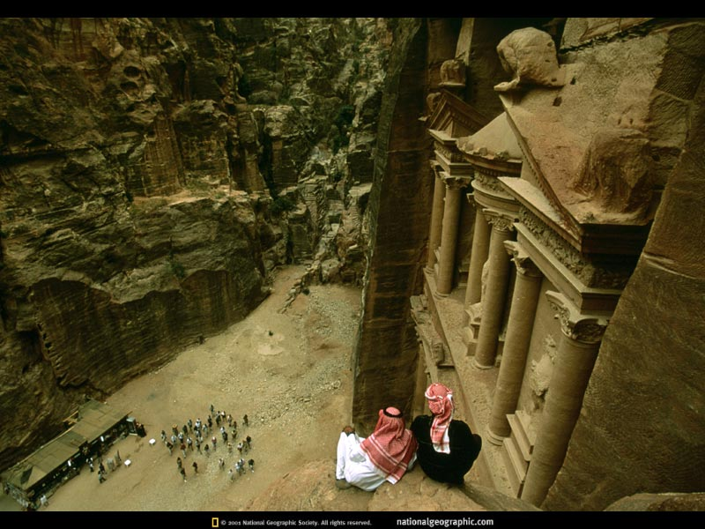
City of Petra, in Jordan one of the 7 New Wonders of the World
End

